Slide 1
AQA Knowledge PowerPoint
Unit 1 Chemistry 1 C1.1 The fundamental ideas in chemistry
Atoms and elements are the building blocks of chemistry. Atoms contain protons, neutrons and electrons. When elements react they produce compounds
C1.1.1 Atoms – no Higher Tier content.
C1.1.2 The periodic table – no Higher Tier content.
C1.1.3 Chemical reactions - Higher Tier candidates should be able to balance
symbol equations.

Slide 2
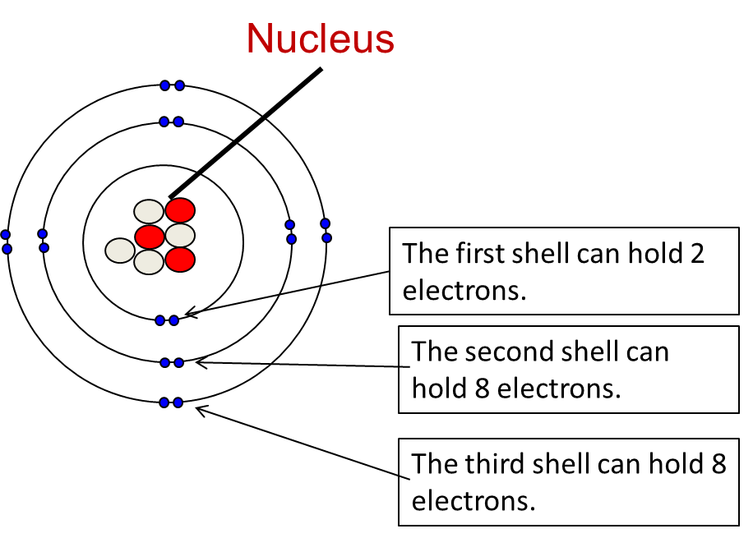
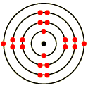
C1.1.1 Atoms
All substances are made of atoms this is cannot be chemically broken down it is the smallest part of an element. Elements are made of only one type of atom. Compounds contain more than one type of atom. Compounds are held together by bonds. Mixtures contain elements and compounds.
STRUCTURE OF THE ATOM: Protons and Neutrons are found in the nucleus. Electrons orbit the nucleus in shells.
An atom contains equal numbers of protons and electrons. All atoms of an element have the same number of protons. Atoms of different elements
have different numbers of protons.
 | Proton | Neutron | Electron
Mass | 1 | 1 | negligible
Charge | + | 0 | -
Location | nucleus | nucleus | shells
Electron configurations can be written 2,8,8
Atoms of each element are represented by a chemical symbol e.g. O for oxygen, Na for sodium.
Mass number = Number of protons and neutrons
7
Li
3
Atomic number = Number of protons
Number of neutrons Mass Number – Atomic Number
Calcium Ca 2,8,8,2

Slide 3
C1.1.2 The periodic table
Each element has its own symbol. Columns are called groups Elements in a group have similar properties. Rows are called periods. The staircase line splits metals (LEFT) from non-metals (RIGHT)
Elements in the same group in the periodic table
have the same number of electrons in their outer shell so they have similar chemical properties.
E.g. Group 1 Alkali metals
Reactions of group 1 elements with water
Lithium, sodium and potassium all react vigorously with water.
metal + water → metal hydroxide + hydrogen
The metal hydroxides are strong alkalis. The group 1 elements need to be stored under oil to prevent them reacting with oxygen and water vapour in the air.
Elements in Group 0 of the periodic table are called the noble gases. They are unreactive because their atoms have stable arrangements of electrons. A full outer shell.
Li
Reactivity
Increases
Na
METALS
K
1
2
3
4
5
6
7
0
Rb
H
He
Cs
Li
Be
B
C
N
O
F
Ne
Na
Mg
Al
Si
P
S
Cl
Ar
K
Ca
Sc
Ti
V
Cr
Mn
Fe
Co
Ni
Cu
Zn
Ga
Ge
As
Se
Br
Kr
Rb
Sr
Y
Zr
Nb
Mo
Tc
Ru
Rh
Pd
Ag
Cd
In
Sn
Sb
Te
I
Xe
Cs
Ba
La
Hf
Ta
W
Re
Os
Ir
Pt
Au
Hg
Tl
Pb
Bi
Po
At
Rn
Fr
Ra
Ac
Rf
Db
Sg
Bh
Hs
Mt
?
?
?
NON - METALS

Slide 4
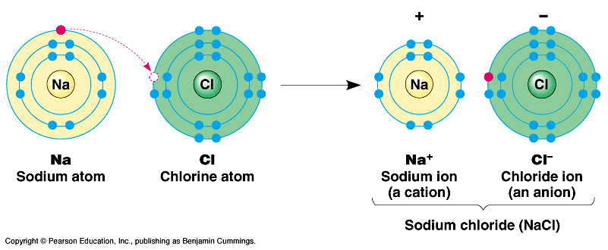
C1.1.3 Chemical reactions
When elements react, their atoms join with other atoms to form compounds. There are two types of bonds formed in a chemical reaction
Ionic Bonding: Metal and non-metal react. Metals form positive ions, Non-metals form negative ions. Opposite charges attract. Metals LOSE electrons Non Metals GAIN electrons.
Covalent Bonding: When two non-metals bond. Outermost electrons are shared . A pair of shared electrons forms a bond
O
O
C
O
H
H
WATER (H₂O)
Carbon dioxide (C O₂)
Na [2,8]⁺ and Cl [2,8,8]⁻
Group 4 elements share 4 electrons. Group 5 elements share 3 electrons. Group 6 elements share 2 electrons. Group 7 elements and hydrogen share 1 electron.
IONS ARE FORMED WHEN ELEMENTS LOSE OR GAIN ELECTRONS THEY ARE CHARGED PARTICLES.
Chemical equations: They show the reactants (what we start with) and the products (what we end with). No atoms are lost or made. The mass of the products equals the mass of the reactants.
Group 1 elements lose 1 electron make ions ⁺, group 2 lose 2 electrons make ions 2⁺, group 6 gains 2 electrons make ions 2⁻, group 7 gains 1 electron make ions 1⁻.
Word Equation: calcium carbonate | → | calcium oxide + carbon dioxide
Symbol Equation: CaCO₃ | → | CaO + CO₂

Slide 5
C1.1.3 Chemical reactions Higher Tier – Balancing equations.
Methane + Oxygen → Carbon dioxide and Water
CH₄ + 2O₂ → CO₂ + 2H₂O
There are 4 hydrogens here, bonded together.
There are 2 molecules of oxygen not bonded together.
There are 4 hydrogens here. You multiply the big number by the little number.
+
+
Equations MUST balance
We can ONLY add BIG numbers to the front of a substance
We can tell elements within a compound by BIG letters
We can check an equation is balanced by counting the number of each type of atom on either side

Slide 6
AQA Knowledge PowerPoint
Unit 1 Chemistry 1 C1.2 Limestone and building materials
Rocks provide essential building materials. Limestone is a naturally occurring resource that provides a starting point for the manufacture of cement and concrete.
C1.2.1 Calcium carbonate – no Higher Tier content.

Slide 7
C1.2.1 Calcium carbonate - Limestone
We use limewater to test for CO₂ it turns cloudy
Limestone is made mainly of Calcium Carbonate CaCO_{3.} Formed from the remains of sea animals that lived millions of years ago. Limestone is quarried (dug out of the ground) and used as a building material. It is also used in the chemical industry and for cosmetics. Cement: Made by heating limestone with clay in a kiln. Mortar: Made by mixing cement and sand with water. Concrete: Made by mixing crushed rocks or stones (called aggregate), cement and sand with water.
Advantages of quarrying | Disdvantages of quarrying
Provide jobs Lead to improved roads Filled in to make fishing When empty used as landfill sites | Destroys habitats Increased emissions Noisy & Dusty Busier roads
Heating limestone
Breaking down of a chemical by heating is called thermal decomposition.
Step 4: Add CO₂
Ca(OH)₂ + CO₂ → CaCO₃ + H₂O
Calcium Carbonate
Step 1: Add Heat
CaCO₃ → CaO + CO₂
Calcium Hydroxide Solution
(Limewater)
Calcium Oxide
Step 2: Add water
CaO + H₂O → Ca(OH)₂
Step 3: More water & filter
Calcium Hydroxide
Calcium hydroxide: Is used to neutralise acidic soils.
The carbonates of magnesium, copper, zinc, calcium and sodium decompose on heating in a similar way

Slide 8
AQA Knowledge PowerPoint
Unit 1 Chemistry 1 C1.3 Metals and their uses
Atoms and elements are the building blocks of chemistry. Atoms contain protons, neutrons and electrons. When
elements react they produce compounds
C1.3.1 Extracting metals – no Higher Tier content.
C1.3.2 Alloys – no Higher Tier content.
C1.3.3 Properties and uses of metals – no Higher Tier content.

Slide 9
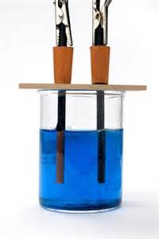
C1.3.1 Extracting metals
A metal compound within a rock is an ore. The metal is often combined with oxygen. Ores are mined and then purified.
Increasing reactivity
The Reactivity Series
Potassium
Sodium
Calcium
Magnesium
Aluminium
Please
Send
Charlie's
Monkeys
And
Copper-rich Ores: Large amounts of copper. 1. Smelting: 80% of copper is produced this way. Heat copper ore in a furnace with air.
Then use electrolysis to purify the copper. Expensive as needs lots of heat and power.
2. Copper Sulphate: Add sulphuric acid to a copper ore. Produces copper sulphate. Extract copper using electrolysis or displacement.
Low Grade Copper Ores: Small amount of copper. 1. Phytomining: Plants absorb copper ions from low-grade ore. Plants are burned. Copper ions dissolved by adding acid. Use displacement or electrolysis to extract pure Copper.
2. Bioleaching: Bacteria feed on low-grade ore
Produce a waste product that contains copper ions
Use displacement or electrolysis to extract pure copper.
CARBON
CRAZY!
Zinc
Iron
Lead
Copper
Silver
Gold
Zebras
In
Lead
Cages
Securely
Guarded
The reactivity of a metal determines the method of extraction. Metals above carbon must be extracted using electrolysis. Metals below carbon can be extracted by reduction using carbon, coke, or charcoal. Gold and silver do not need to be extracted. They occur native (naturally).
During electrolysis: In a solution or molten compound when electricity is passed through it positive metal ions move towards the negative electrode. Negative non metal ions move towards the positive electrode.

Slide 10
C1.3.1 Extracting metals
It is good to recycle metals:
Reduces the energy needed to extract them and process them as much less energy is needed to recycle metals than extract from their ore. Less pollution due to less processing and not as many vehicles needed to transport. Stops the landscape being destroyed and disruption to wildlife and people living near.
 | Aluminium | Titanium
Property | Light, Low density, Oxide layer on the surface prevents corrosion, Improve hardness by forming alloys. These alloys are stronger and rigid than pure Al. | Strong, Oxide layer on the surface prevents corrosion, High melting point – so can be used at high temperatures, Less dense than most metals
Use | Uses: Drinks cans, cooking oil, saucepans, overhead cables, aeroplanes. | Uses: Hip replacements, racing bikes, jet engines, parts of nuclear reactors.
Extraction | Aluminium ore is mined and extracted. Aluminium oxide (the ore) is melted. Electric current passed through a high temperature Expensive process – need lots of heat and electricity | Use sodium or potassium to displace titanium from its ore Expensive – lots of steps involved to process and needs lots of heat and electricity.

Slide 11
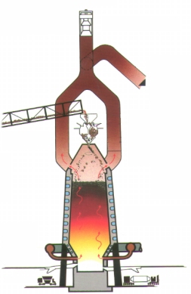
C1.3.2 Alloys
A metal mixed with other elements is called an ALLOY. Alloys are harder than pure metals.
Extracting Iron
Iron ore goes into the blast furnace and the iron is removed from iron oxide by carbon. Reactions in which oxygen is removed are called reduction reactions.
Iron from the blast furnace contains about 96% iron. The impurities make it brittle and so it has limited uses.
Pure metal – regular pattern layers slide easily over each other.
Alloy – other element disrupts regular pattern layers DO NOT slide easily over each other.
IRON ALLOYS Steel → Iron with carbon and/or other elements. Impurities make it brittle. There are a number of types of steel alloys: Low carbon steel – easily shaped, High carbon steels – very hard, Stainless steels – resistant to corrosion | ALUMINIUM ALLOYS Aluminium naturally soft Mixed with wide range of other elements All have very different properties E.g. in aircraft or armour plating!
COPPER ALLOYS Copper naturally soft Bronze (Copper + Tin) Tough, Resistant to corrosion, Brass (Copper + Zinc), Harder but workable | GOLD ALLOYS Copper naturally soft Usually add Copper to make jewellery stronger and last longer.

Slide 12
C1.3.3 Properties and uses of metals
Transition Metals have the following properties: Shiny when polished, Malleable – can be hammered into a shape, Strong, don’t break easily when a force is applied, High melting point , Sonorous – makes a ringing sound when hit, Ductile – can be stretched into wires, Conducts electricity and heat.
Used as structural metals to make, buildings, bridges, cars.
1
2
3
4
5
6
7
8
H
He
Li
Be
Transition Metals
B
C
N
O
F
Ne
Na
Mg
Al
Si
P
S
Cl
Ar
K
Ca
Sc
Ti
V
Cr
Mn
Fe
Co
Ni
Cu
Zn
Ga
Ge
As
Se
Br
Kr
Rb
Sr
Y
Zr
Nb
Mo
Tc
Ru
Rh
Pd
Ag
Cd
In
Sn
Sb
Te
I
Xe
Cs
Ba
La
Hf
Ta
W
Re
Os
Ir
Pt
Au
Hg
Tl
Pb
Bi
Po
At
Rn
Fr
Ra
Ac
Rf
Db
Sg
Bh
Hs
Mt
Copper has properties that make it useful for electrical wiring and plumbing. Not very reactive, excellent conductor of electricity, easily bent into shape for water pipes in plumbing.

Slide 13
AQA Knowledge PowerPoint
Unit 1 Chemistry 1 C1.4 Crude oil and fuels
Crude oil is derived from an ancient biomass found in rocks. Many useful materials can be produced from crude oil. Crude oil can be fractionally distilled. Some of the fractions can be used as fuels. Biofuels are produced from
plant material. There are advantages and disadvantages to their use as fuels. Fuels can come from renewable or non-renewable resources.
C1.4.1 Crude oil – no Higher Tier content.
C1.4.2 Hydrocarbons – no Higher Tier content.
C1.4.3 Hydrocarbon fuels – no Higher Tier content.

Slide 14
C1.4.1 Crude oil/ C1.4.2 Hydrocarbons
Crude Oil: A mixture of lots of different compounds. Formed from dead sea creatures over millions of years. We separate it into substances with similar boiling points. These are called fractions. This is done in a process called fractional distillation.
Nearly all the compounds in crude oil are hydrocarbons (hydrogen and carbon only). Most of these are ALKANES. Alkanes have all single bonds and the general formula C_{n}H_{2n+2.}
Fractional distillation
→ Refinery Gas (fuel)
→ Petrol (cars)
→ Naphtha (industry)
→ Kerosene (jet fuel)
→ Diesel (engines)
→ Residue (road surface)
Methane CH₄
Fractions with low boiling points condense at the top.
Fractional
Distillation
Ethane C₂H₆
Longer chains mean…
Less ability to flow
Less flammable
Less volatile
Higher boiling point
Increasing length
Propane C₃H₈

Slide 15
C1.4.3 Hydrocarbon fuels
Combustion of hydrocarbons: When burnt in an adequate supply of air alkanes react to form carbon dioxide, e.g.
propane + oxygen → carbon dioxide + water
When burnt in not enough oxygen carbon monoxide is formed
propane + oxygen → carbon monoxide + water
Global Warming: Caused by carbon dioxide, Causing the average global temperature to increase. Global Dimming
Caused by particulates
Reflect sunlight back into space. Not as much light gets through to the Earth
Fossil fuels also produce a number of impurities when they are burnt, main pollutants are summarised below
Sulfur Dioxide | Nitrogen Oxide | Particulates
Poisonous gas It’s acidic Causes acid rain Causes engine corrosion | Poisonous Trigger asthma attacks Can cause acid rain | Tiny solid particles Contain carbon and un burnt hydrocarbon Carried in the air Damage cells in our lungs
Sulphur Dioxide gas is produced in vehicles and PowerStation's when fuel containing sulfur is burned. The sulfur dioxide dissolves in rain and produces acid rain. The sulfur dioxide can be removed from the waste gases in cars by catalytic converters and in PowerStation's by reacting it with limestone.
Biodiesel Advantages | Biodiesel Disadvantages
Less harmful to animals, Reduces particulates, ‘CO₂ neutral’ – plants grown to create it absorb the same amount of CO₂ generated when it’s burnt | Large areas of farmland required, Less food produced → Famine Destruction of habitats Freezes at low temps
Hydrogen fuel: ADVANTAGES: Very clean – no CO_{2,}Water is the only product. DISADVANTAGES: Hydrogen is explosive, Takes up a large volume → storage becomes an issue.
Ethanol fuel: ADVANTAGES: Easily made by fermenting sugar cane, Gives off CO₂ but the sugar cane it comes from absorbs CO₂ when growing. DISADVANTAGES: Large areas of farmland required, Less food produced as people use it for fuel instead!

Slide 16
AQA Knowledge PowerPoint
Unit 1 Chemistry 1 C1.5 Other useful substances from crude oil
Fractions from the distillation of crude oil can be broken down (cracked) to make smaller molecules including unsaturated hydrocarbons such as ethene. Unsaturated hydrocarbons can be used to make polymers and ethene can be used to make ethanol. Ethanol can also be made by fermentation.
C1.5.1 Obtaining useful substances from crude oil – no Higher Tier content.
C1.5.2 Polymers – no Higher Tier content.
C1.5.3 Ethanol - no Higher Tier content.

Slide 17
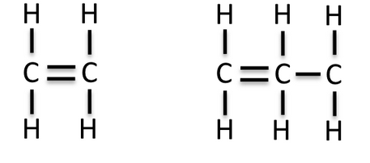
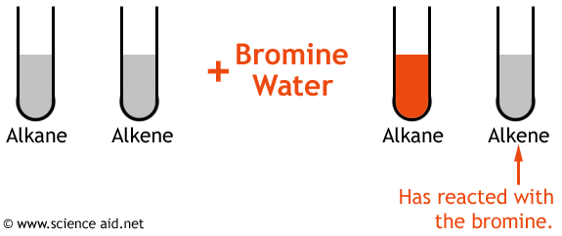
More demand for shorter chain hydrocarbons. Short chain preferred so longer chain ‘cracked’ to make shorter ones
C1.5.1 Obtaining useful substances from crude oil
Alkenes – Alkenes are hydrocarbons (made up of carbon and hydrogen) with a carbon-carbon double bond (C=C). They have the general formula C_{n}H_{2n} (2 hydrogens for every carbon)
Cracking – this is when a large alkane is turned into a smaller alkane and an alkene.
You can ‘crack’ it into smaller, more useful hydrocarbons
Hexane → butane + ethene
C₁₀H₂₂ → C₅H₁₂ + C₂H₄
TESTING FOR ALKENES: You can use bromine water to work out if you have an alkene. Bromine water is brown. Alkenes make it colourless. Alkanes do not change the colour (it stays brown).

Slide 18
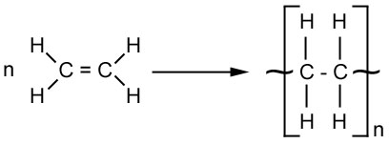
C1.5.2 Polymers
Smart Polymers: Their properties changed by light, temperature or
other changes in their surroundings.
Alkenes can be used to make polymers such as poly(ethene) and poly(propene). In these reactions, many small alkane molecules (monomers) join together to form very large molecules (polymers). This happens at very high pressure and temperature.
Light-Sensitive Plasters | Hydrogels | Shape memory
Top layer of plaster peeled back. Lower layer now exposed to light. Adhesive loses stickiness Peels easily off the skin. | Have cross-linking chains That traps water. Act as wound dressings. Let body heal. Good for burns | Wound is stitched loosely. Temp of the body makes the thread tighten. Closes the wound up
Monomers
Polymerisation
Polymers
Biodegradable Plastics: Plastics that break down easily. Corn-starch are built into the plastic. Microorganisms in soil feed on corn-starch. This breaks the plastic down.
Poly(propene)
Propene
Cracking
Polymer | Typical use
polythene | plastic bags and bottles
polypropene | crates and ropes
polychloroethene | water pipes and insulation on electricity cables
Issues with polymers:
Biodegradable - Farmers sell crops like corn to make plastics, demand for food goes up, food prices go up. Non – biodegradable - Don’t break down, litter, harm wildlife, last 100’s of years, fill up landfill sites.

Slide 19
C1.5.3 Ethanol
Ethanol can be produced by the hydration of ethene with steam in the presence of a catalyst. Or by fermentation with yeast. It is a flammable colourless liquid BP 78ºC
Ethanol can be made by Fermentation
Sugar + Yeast → Ethanol + Carbon Dioxide
Ethanol can also be made by hydration (Adding water to) ethene
Ethene + Steam → Ethanol
C₂H₄ + H₂O → C₂H₅OH
Fermentation | Hydration
Uses corn, sugar cane (renewable resources). | Uses crude oil, which is a non-renewable resource.
Is a batch process, which needs a lot of workers | Is a continuous process so is less labour intensive
Produces impure ethanol, and is purified by distillation | Produces pure ethanol
Needs a temperature of 30-40 ºC | Needs a temperature of 300 ºC and high pressure
Is a slow reaction | Is a fast reaction
Uses of ethanol: alcoholic drinks, fuel, solvent, deodorants, medicine, perfumes.

Slide 20
AQA Knowledge PowerPoint
Unit 1 Chemistry 1 C1.6 Plant oils and their uses
Many plants produce useful oils that can be converted into consumer products including processed foods. Emulsions can be made and have a number of uses. Vegetable oils can be hardened to make margarine. Biodiesel fuel can be produced from vegetable oils.
C1.6.1 Vegetable oils – no Higher Tier content.
C1.6.2 Emulsions - Higher Tier - Emulsifiers have hydrophilic and hydrophobic properties.
Knowledge is limited to a simple model of the structure of emulsifier molecules.
C1.6.3 Saturated and unsaturated oils - Higher Tier - Vegetable oils that are unsaturated can be hardened by reacting them with hydrogen in the presence of a nickel catalyst at about 60°C. Hydrogen adds to the carbon–carbon double bonds. The hydrogenated oils have higher melting points so they are solids at room temperature, making them useful as spreads and in cakes and pastries.
Candidates should know how and why vegetable oils are hardened for use in foods. Knowledge of trans fats is not required.

Slide 21
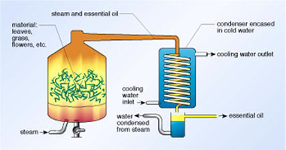
C1.6.1 Vegetable oils
Some fruits, seeds and nuts are rich in oils that can be extracted.
Vegetable oils are important foods:
Provide important nutrients (e.g. vitamin E), Contain lots of energy → can be used as fuels
Unsaturated oils contain double bonds (C=C) → they decolourise Bromine water
Extracting oils
Pressing | Distillation
Farmers collect seeds from plants Seeds are crushed and pressed, then the oil extracted Impurities are removed Oil is processed to make it into a useful product | Plants are put into water and boiled Oil and water evaporate together Oil is collected as the liquids separate e.g. lavender oil
Benefits of cooking with oil:
Oil has a higher boiling point than water.
Food cooks quicker
Outside becomes crispier
Inside becomes softer
Food absorbs some of the oil
Higher energy content
Too much is unhealthy

Slide 22
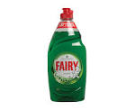
C1.6.2 Emulsions
Oils do not dissolve in water, they are immiscible. They don’t mix and form layers. Emulsions - Where oil and water are dispersed (spread out) in each other. They have special properties.
Emulsifiers
Stop water and oil separating out into layers
Improve texture and taste of foods containing fats and oils.
Makes them more palatable (tasty) and tempting to eat!
A food additive is a substance that is added to a food to improve its taste, preserve it or change its colour. All food additives in our food have an E number to prove that they have passed a safety standard.
Emulsifiers have an E number that begins with 4.
Emulsifiers stop oil and water based substances from separating. Emulsifiers are needed in chocolate, mayonaise and ice cream.
Higher Tier Only
Emulsifiers have 2 parts that make them work
–
Hydrophobic tail – is attracted to oil
–
–
–
–
Hydrophilic head – is attracted to water. Has a negative charge.
–
–
–
Oil droplet IN WATER
Washing up liquid (detergent) is an emulsifier

Slide 23
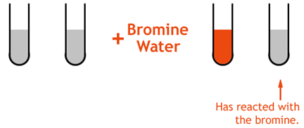
C1.6.3 Saturated and unsaturated oils
Vegetable Oils
Unsaturated Fats contain double carbon bonds C=C
Liquid at room temp.
Source of nutrients like vitamin E
Keep arteries clear
Reduce heart disease
Lower cholesterol levels
E.g. sunflower oil, olive oil
Animal Fats
Saturated Fats contain single carbon bonds C-C
Solid at room temperature.
Are not good for us
Increase risk of heart disease
Increase cholesterol
E.g. butter, lard
TESTING FOR ALKENES: You can use bromine water to work out if you have an alkene. Bromine water is brown. Alkenes make it colourless. Alkanes do not change the colour (it stays brown).
Animal
fat
Vegetable oil
Animal
fat
Vegetable oil
Higher Tier Only
Reacting vegetable oils with hydrogen hardens them → increases melting points
Makes them solid at room temperature → makes them into spreads!
Double bonds converted to single bonds C=C → C-C
Now called a hydrogenated oils
Reaction occurs at 60ºC with a nickel catalyst

Slide 24
AQA Knowledge PowerPoint
Unit 1 Chemistry 1 C1.7 Changes in the Earth and its atmosphere
The Earth and its atmosphere provide everything we need. The Earth has a layered structure. The surface of the Earth and its atmosphere have changed since the Earth was formed and are still changing. The atmosphere has been much the same for the last 200 million years and provides the conditions needed for life on Earth. Recently human activities have resulted in further changes in the atmosphere. There is more than one theory about how life was formed.
HT -describe why we do not know how life was first formed.
C1.7.1 The Earth’s crust – no Higher Tier content.
C1.7.2 The Earth’s atmosphere Higher Tier - One theory as to how life was formed involves the interaction between hydrocarbons, ammonia and lightning.
Candidates should be aware of the Miller Urey experiment and the ‘primordial soup’ theory, but they should know that this is not the only theory.
Air is a mixture of gases with different boiling points and can be fractionally distilled to provide a source of raw materials used in a variety of industrial processes.

Slide 25
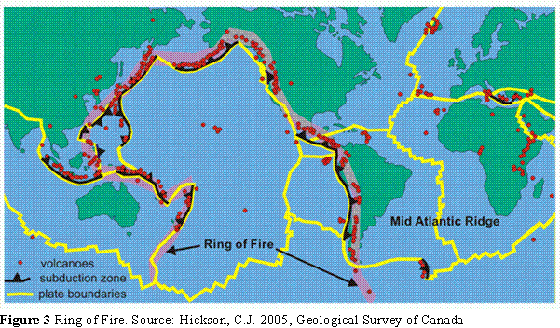
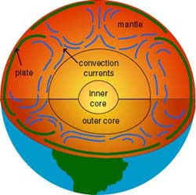
C1.7.1 The Earth’s crust
The Earth’s crust, the atmosphere and the oceans are the only source of minerals and other resources that humans need
Atmosphere: Most lies within 10km of the surface, Rest is within 100km but it’s hard to judge!
Core: Made of nickel and iron
Outer core is liquid
Inner core is solid
Radius is 3500km
Crust: Solid, 6km beneath oceans,35km beneath land
Mantle: Behaves like a solid
Can flow very slowly
Is about 3000km deep!
Moving Continents
The Earth’s crust and upper mantle are cracked into a number of pieces → tectonic plates.These are constantly moving - just very slowly. Motion is caused by convection currents in the mantle, due to heat from radioactive decay.
Plate Boundaries: The Earth’s crust is split into sections called tectonic plates. Earthquakes and volcanoes happen when plates meet - very difficult to predict
Wegener’s evidence for continental drift: The same types of fossilised animals and plants are found in South America and Africa. The shape of the east coast of South America fits the west coast of Africa, like pieces in a jigsaw puzzle. Matching rock formations and mountain chains are found in South America and Africa
Pangea: If you look at the continents they roughly fit together. Scientists think they were once one large land mass called Pangea, which then broke off into smaller chunks

Slide 26
C1.7.2 The Earth’s atmosphere
The Carbon Cycle
The Earth’s Atmosphere Today: For 200 million years, the proportions gases in the atmosphere similar to today:
CO₂ in air and oceans
Carbon Dioxide Levels:
Have increased in the atmosphere recently largely due to the amount of fossil fuels we now burn.
Combustion
Photosynthesis
Respiration
Fossil
fuels
Decay
Animals
Plants
Gas | Formula | %
Nitrogen | N₂ | 80
Oxygen | O₂ | 20
Carbon dioxide | CO₂ | 0.04
Feeding
Death
Fossilisation
Decay
Dead animals and plants
Evolution of the Earth’s Atmosphere
Phase 1 (1st billion yrs) | Phase 2 | Phase 3
Volcanoes = Steam & CO₂ | Green Plants, Bacteria & Algae = Oxygen | Ozone Layer = Animals & Us
Volcanoes kept erupting giving out Steam and CO₂ The early atmosphere was nearly all CO₂ The earth cooled and water vapour condensed to form the oceans | Green plants, bacteria and algae photosynthesised in the oceans. Green plants steadily converted CO₂ into O₂ by the process of photosynthesis Nitrogen released by denitrifying bacteria Plants colonise the land. Oxygen levels steadily increase | The build up of O₂ killed off early organisms - allowing evolution of complex organisms The O₂ created the Ozone layer (O₃) which blocks harmful UV rays from the sun Virtually no CO₂ left

Slide 27
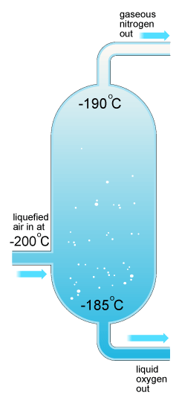
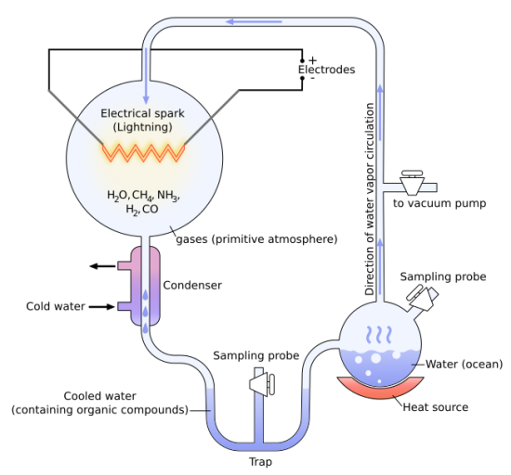
C1.7.2 The Earth’s atmosphere – Higher Tier Only
No one can be sure how life on Earth first started. There are many different theories:
Miller-Urey Experiment
Compounds for life on Earth came from reactions involving hydrocarbons (e.g. methane) and ammonia. The Miller-Urey experiment took place in 1953. They used water, methane, ammonia and hydrogen and passed an electric spark through them. They got 11 amino acids.
It supports the theory of a ‘primordial soup’, the idea that complex chemicals needed for living things to develop could be produced naturally on the early Earth.
Other Theories
Molecules for life (amino acids) came on meteorites from out of space.
Actual living organisms themselves arrived on meteorites.
Biological molecules were released from deep ocean vents.
Fractional Distillation of air
The main gases in air can be separated out by fractional distillation. The gases are cooled to a temperature below -200ºC and gradually heated up.
These gases are useful in industry:
Liquid nitrogen used to freeze food
Nitrogen gas used to flush oil tankers to reduce the chance of explosion and for packing food.
Oxygen is used in the manufacture of steel and in medicine.

